Slide 1
Polynomial Regression

Slide 2
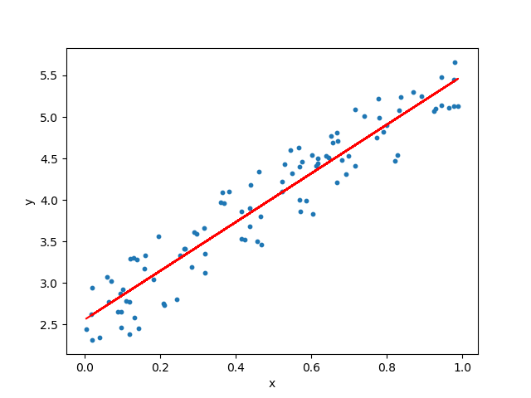

In Linear Regression, the relationship between the dependent and independent variable is linear
But here you have one dependent and one independent variable.
Simple Linear Regression
Equation
$$Y=β_{0}+β_{1}X+ε$$

Slide 3
In Linear Regression, the relationship between the dependent and independent variable is linear
But here you have one dependent and multiple independent variable.
MultiLinear Regression
Equation
$$Y=β_{0}+β_{1}X_{1}+β_{2}X_{2}+β_{3}X_{3}+…………..+β_{n}X_{n}+ε$$

Slide 4
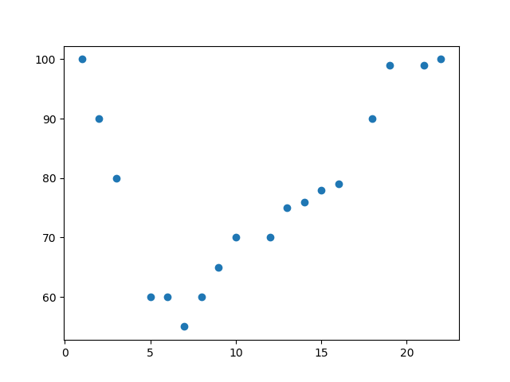
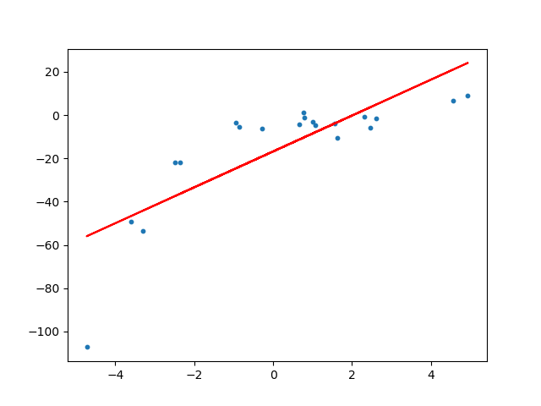
Some times the data or the distribution of the data is more complex.
The data may not be Linear.
The Linear models we have seen will not be able to fit non linear data.
Complex Data:
The above line under fits the data points.

Slide 5
Polynomial Regression:
Polynomial regression, like linear regression, uses the relationship between the variables x and y to find the best way to draw a line through the data points.
So instead of a straight line we require a curve fitting line.

Slide 6
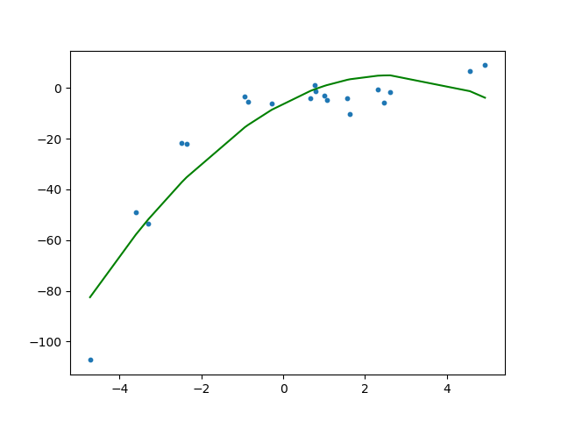
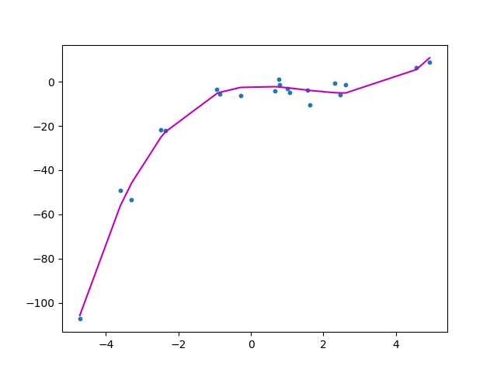

Slide 7
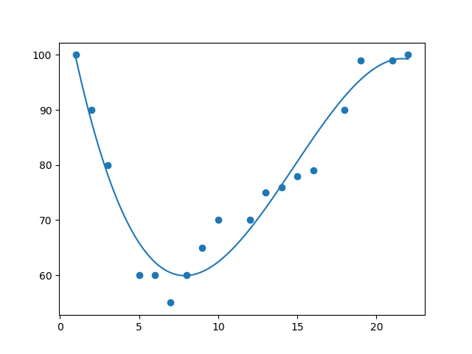
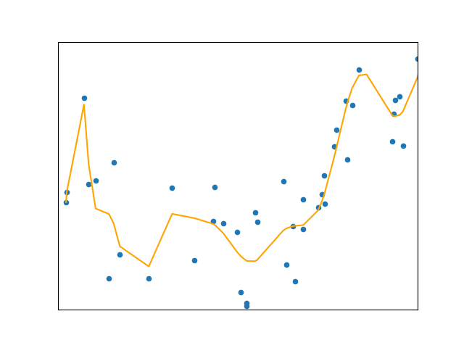
It is clear from the above plot that the quadratic curve is able to fit the data better than the linear line.

Slide 8

To overcome under-fitting, we need to increase the complexity of the model.
To generate a higher order equation we can add powers of the original features as new features.
Therefore the linear model,
$$Y=β_{0}+β_{1}X$$
Can be transformed to
$$Y=β_{0}+β_{1}X+β_{2}X^{2}+β_{3}X^{3}+………+β_{n}X^{n}+ε$$
The order can be 2 or 3 or 4, so on till n.
But the most we will go for is the 2nd order.
This is still considered to be linear model as the coefficients/weights associated with the features are still linear.
x² is only a feature.
However the curve that we are fitting is quadratic in nature.

Slide 9

$$Y=β_{0}+β_{1}X+β_{2}X^{2}+ε$$
The order can be 2 or 3 or 4, so on till n.
But the most we will go for is the 2nd order.
This is still considered to be linear model as the coefficients/weights associated with the features are still linear.
x² is only a feature.
However the curve that we are fitting is quadratic in nature.
It can be cubic also.
It can be 15 or 20 and so on.

Slide 10

2nd Order: Quadratic
$$Y=β_{0}+β_{1}X+β_{2}X^{2}+ε$$

Slide 11
3rd Order: Cubic

Slide 12
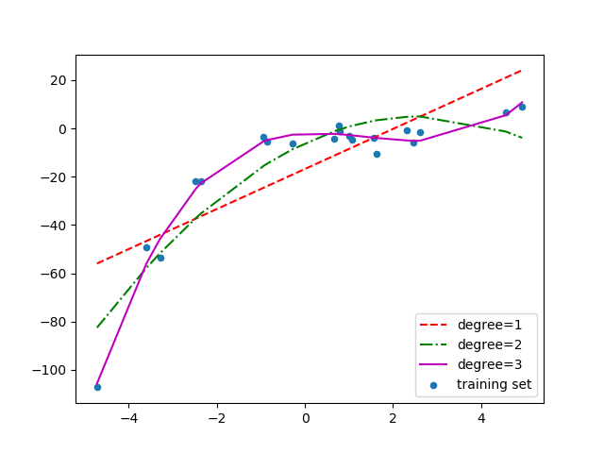
Below is a comparison of fitting linear, quadratic and cubic curves on the dataset.

Slide 13
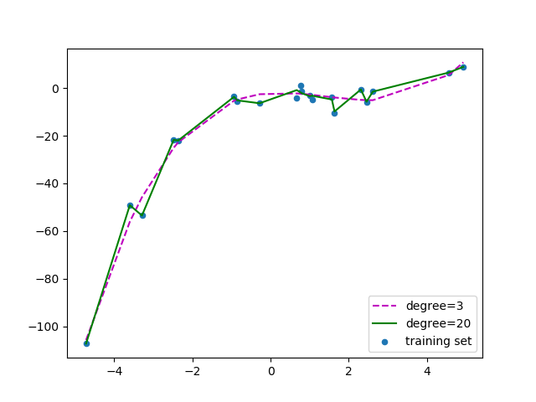
If we further increase the degree to 20, we can see that the curve passes through more data points. Below is a comparison of curves for degree 3 and 20.
For degree=20, the model is also capturing the noise in the data. This is an example of over-fitting. Even though this model passes through most of the data, it will fail to generalize on unseen data.

Slide 14
To prevent over-fitting, we can add more training samples so that the algorithm doesn’t learn the noise in the system and can become more generalized.
It is always preferred to have the order of the polynomial to be less than or equal to 2.

Slide 15

Equation:
$$Y=β_{0}+β_{1}X+β_{2}X^{2}+ε$$

Slide 16
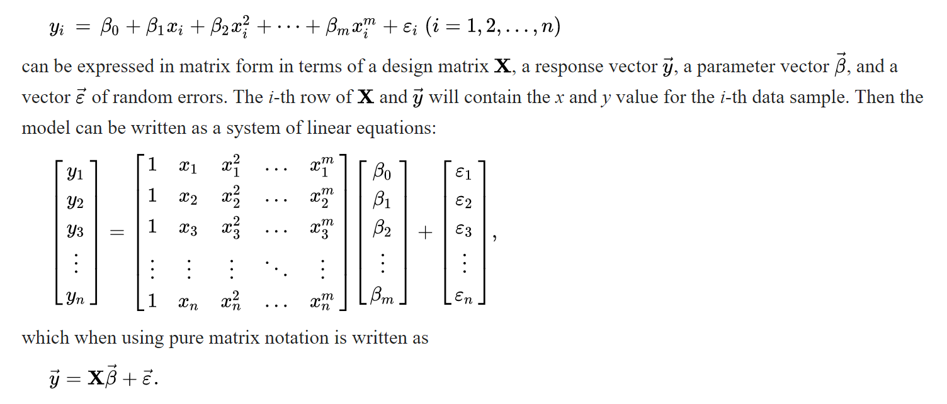
Matrix form and calculation of estimates
The polynomial regression model
$$y_{i}=β_{0}+β_{1}x_{i} + β_{2}x_{i}^{2}+β_{3}x_{i}^{3}+…………..+β_{n}x_{i}^{n}+ε$$

Slide 17


Equation:
$$Y=β_{0}+β_{1}X+β_{2}X^{2}+ε$$
How to find the X coeffecients, that is
$$β_{0}, β_{1}, β_{2} and so on$$
The equation is the same as Linear Regression
$$\hat{β}={\left(X^{T}X\right)}^{1}X^{T}Y$$

Slide 18


Once
$$β_{0}, β_{1}, β_{2} and so on$$
is known, we can fit them in the below equation
$$Y=β_{0}+β_{1}X+β_{2}X^{2}+ε$$

Slide 19
If more number features are there, then the equation will change to:
For example if there are 2 features X1 and X2, then the equation will change to:
$$Y=β_{0}+β_{1}X_{1}+β_{2}X_{1}^{2}+β_{1}X_{2}+β_{2}X_{2}^{2}+ε$$
The major issue with Multivariate Polynomial Regression is the problem of Multicolinearity. When there are multiple re- gression variables, there are high chances that the variables are interdependent on each other.

Slide 20
